Slide 1

Molten Glass Energy Storage Reservoir
Halotechnics GameChanger Stage Gate Review
Dr. Justin Raade, CEO and Founder
Matt Jonemann, Engineering Manager
December 17, 2014
www.halotechnics.com

Slide 2
Phase 1 work: Heat pump
Electricity
Motor
High Quality Heat Stored
Generator
compress
steam turbine
400 °C
Waste
Heat
air in
200 °C
air out
expander

Slide 3
Phase 1 work: Commercial feasibility

Slide 4
Phase 1 work: Conclusions
Equipment needed for high temperature heat pump is technically feasible but not commercially available
Reducing cost is #1 priority in energy storage market
Electrical resistive heater and molten salt energy storage has near-term commercial opportunities
Molten glass energy storage may further reduce storage cost

Slide 5
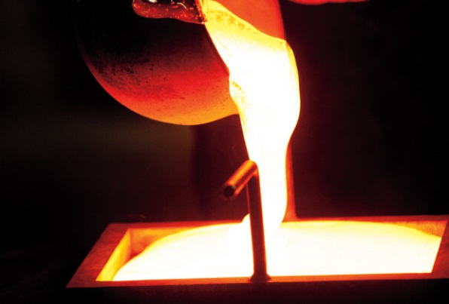
A new energy storage platform
Molten glass enables new energy storage platform
Inherently cheap storage material (low $/kWh)
4x storage density vs. molten salt (high kJ/L)
New storage applications
Low cost electrical energy storage
Greater flexibility in gas turbines by storing heat at full combustion gas temperature
Low carbon steam production
Discharging
Molten salt
Air
Steam
Charging
Electrical energy
Combustion

Slide 6
Integrate into existing thermal power plants
Inject heat further upstream:
Higher temperature (higher efficiency, higher energy density)
Leverage more existing equipment (lower capex)
Typical combined cycle power plant with heat injection points
95 °C
50 °C
Heat Recovery Steam Generator
1600 °C
600 °C
Generator
Gas Turbine
Steam Turbine
Generator
540 °C
FireBoostTM
(molten glass, TBD)
HeatBoostTM
(molten glass)
SteamBoostTM
(molten salt)

Slide 7
Showstoppers to molten glass energy storage
Lessons learned from previous work with phosphate and vanadium based glasses
 | Showstopper |  | Solution
1. | Pumpable glass manufactured cost too high |  | Use soda lime glass, Na₂O-CaO-SiO₂, ~$200/ton
2. | No practical containment material |  | Use zirconia ceramics, proven for years with soda lime glass
3. | No interface to power block |  | Control heat release with salt or air, no glass pumping
Halotechnics has unique capabilities and can build on previous experience to develop practical molten glass energy storage

Slide 8
Molten glass energy storage reservoir
Air Inlet
Air Outlet
Molten Glass
Ceramic Insulation
Refractory Lining
Electrode Heaters
Tank Shell
Patent pending

Slide 9
Market driven design
Decentralized generation (20-50 MW) is the correct size for procurement
Utilities have built hundreds of natural gas peaker plants in this size range
Sufficient discharge profile (4 hours duration on 3 consecutive days) to qualify for “capacity payments”
Utilities pay for standby power, available upon demand.
Typical payment is in $/kW-month regardless of hours of operation
Use the minimum required storage output duration
Reduces capex required to qualify for capacity payments
Plant must last >10 years for good project economics
Commercial viability requires 20-50 MW, 4 hours storage plant with minimum 10 year life

Slide 10
Dimensions and storage capacity
22 m
Base-case design:
Top View
Glass reservoir sized for 2000 ton inventory (common in glass industry)
Square footprint (22 m x 22 m) to reduce surface area and cost
1.8 m (72”) glass pool depth is feasible with standard furnace designs
22 m
Front View
At target ΔT of 500 °C, design can store 400 MWht, enough for
40 MWe, 4 hours storage
1.8 m

Slide 11
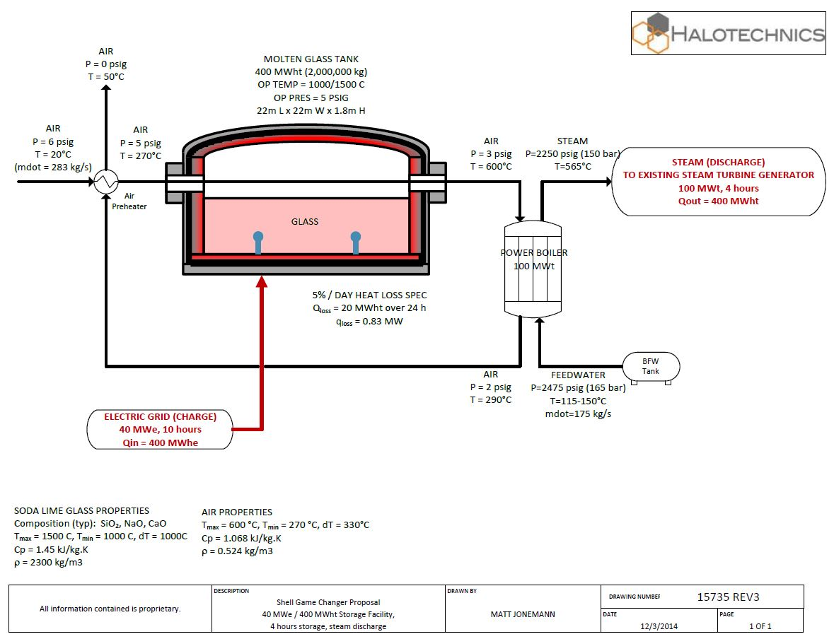
Base-case design: Process flow diagram
Patent pending

Slide 12
Capital cost budget
Given revenues from capacity payments and estimated O&M costs, how much capital cost can we allow and still achieve an acceptable IRR?
Target 10-15% IRR requires furnace costs <$25-30 million
Assumptions:
40 MW, 4 hours storage
Glass inventory: $0.4 million
Soft costs (project development, permitting): 5% capex
O&M costs: 2% capex annually
Rebuild furnace every 10 years
$10/kW-month capacity payments
Molten glass shows promise as commercially viable energy storage technology

Slide 13
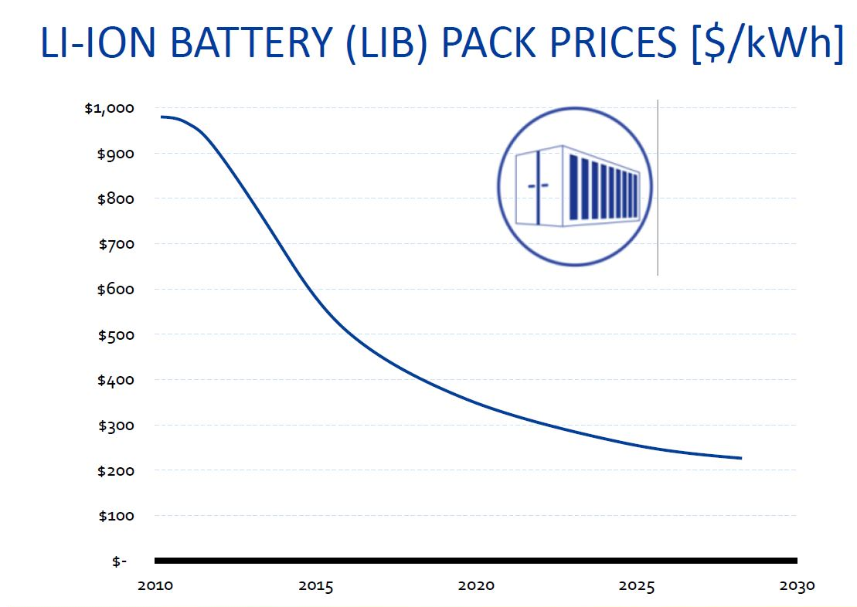
Differentiated solution
Credit: Bloomberg New Energy Finance, 2014
Molten glass enables differentiated technology roadmap
SteamBoostTM
(molten salt)
HeatBoostTM
(molten glass)

Slide 14
Technical challenges
✓
Glass properties suitable for storage
Inherently low cost and stable
Charging
Electrode heater power
Electrode heater lifetime
Storing
Heat losses through tank walls
Thermal cycling
Thermal shock to refractories
Thermal expansion of tank
Discharging thermal energy from glass
Achieving high heat flux
Controlling discharge rate
Heat transfer to power block
Risk Profile:
Feasible
Need GameChanger!
✓
✓
!
✓
!
!

Slide 15
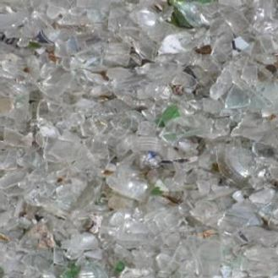
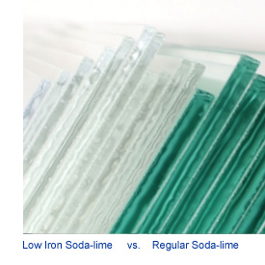
Glass properties
Glass could be used as a stable, low-cost thermal energy storage media
✓
Glass cullet (sorted, recycled glass) available in millions of tons annually at <$200/ton
Want low-iron clear glass for better radiative heat transfer from bulk (<0.1% Fe₂O₃)
Typical clear glass cullet
Property | Value
Typical composition by weight (soda lime window glass) | 73% SiO₂, 14% Na₂O, 9% CaO, 4% MgO, 0.15% Al₂O₃, 0.1% Fe₂O₃
Heat capacity (Cp) | 1.45 kJ/kg-K
Density (ρ) | 2300 kg/m³
Maximum temperature stability (alkali volatilization) | 1500-1600 °C
Softening point | 700-800 °C

Slide 16
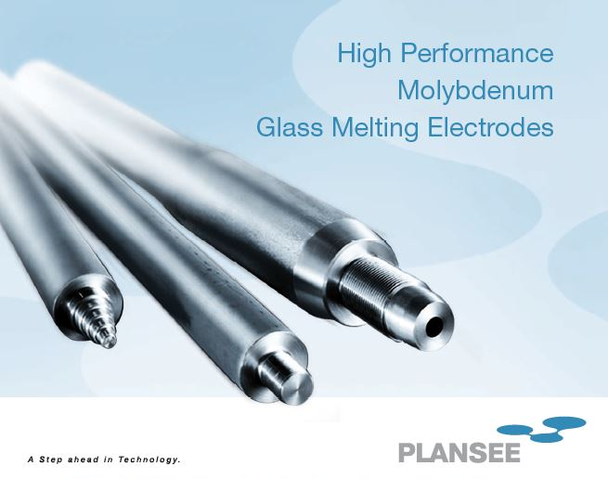
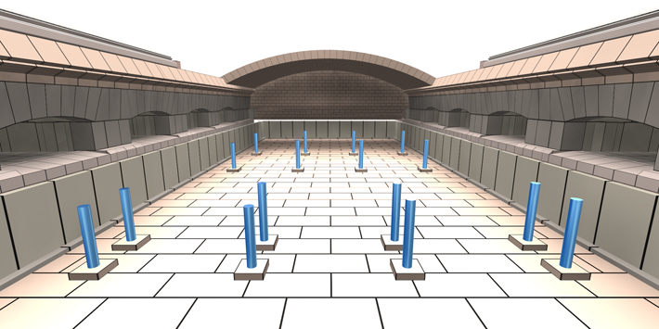
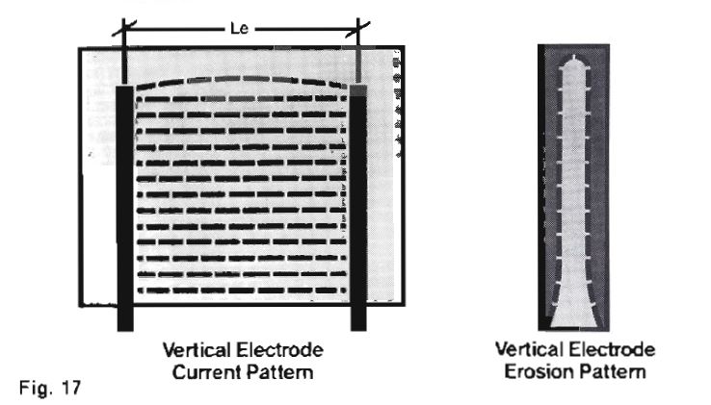
Charging
It is feasible to achieve 40 MW heating power or more with standard electrodes
✓
Molten glass is a good electrical conductor
Electric glass melting furnaces up to 300 tons/day in commercial use
Molybdenum electrode heaters can last for entire furnace campaign (7-10 years)

Slide 17
Storing: heat losses through tank walls
Tg
T2
T5
T1
T3
T4
T6
Ta
Assume 2000 ton glass inventory (size of large commercial float glass furnace)
Thin AZS refractory layer for corrosion resistance
~18” firebrick layer for low-cost, resilient insulation. Forms “self sealing” cold zone
Steel shell for structural strength
Additional external insulation to reduce heat losses
It is feasible to achieve <5% heat losses per day with standard insulating materials
✓
Molten Glass
1500 °C
Air
Air
Tank temperature
25 °C
AZS refractory
Firebrick
<0.6 kW/m² heat losses
Insulation
Steel shell

Slide 18
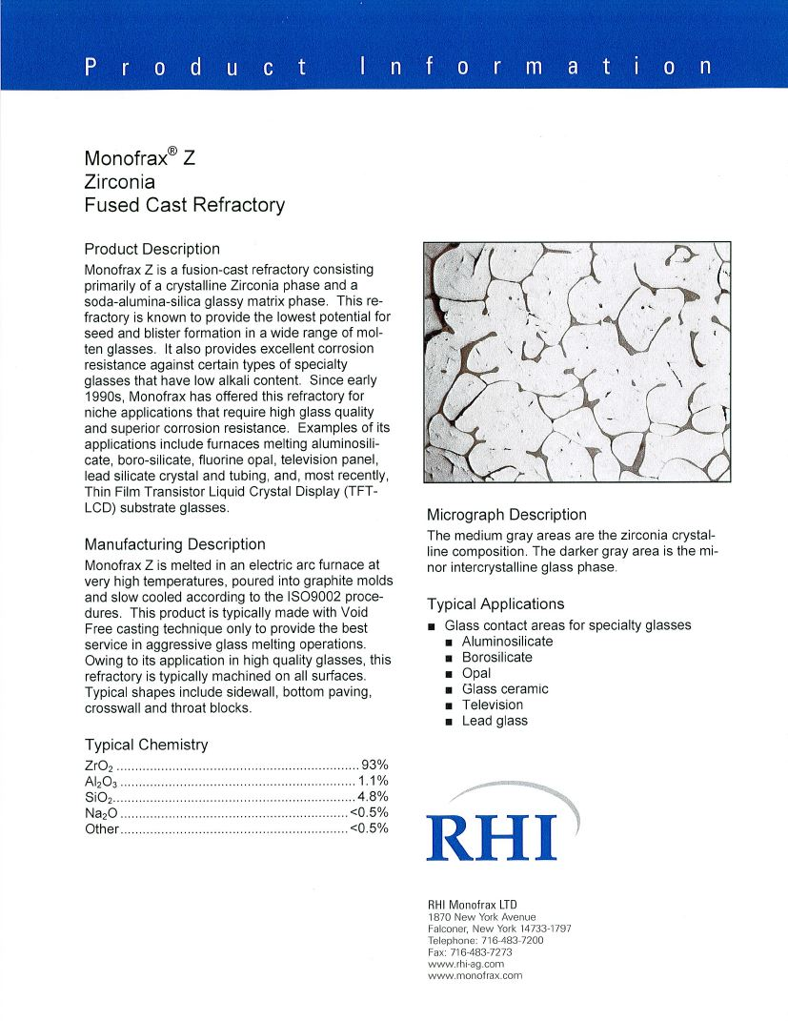
Thermal cycling
Must verify that refractory can withstand 2000 thermal cycles (10+ year life)
!
Refractories can typically withstand some thermal swings, for example due to idling a furnace over the weekend
High temperature ramp rates result in higher stresses
ASTM standard for thermal shock resistance measures strength after repeated, rapid cycling from 1200 °C to room temperature
Too severe to predict behavior for our system

Slide 19

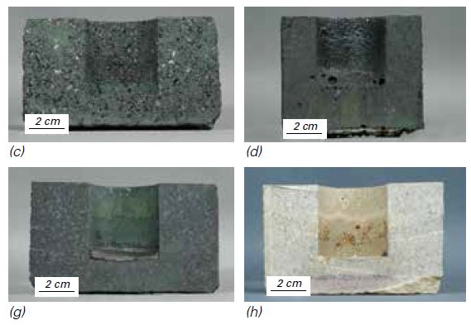
Refractory thermal cycling and corrosion tests
Test thermal cycling first, then corrosion resistance (will be a trade-off)
Chromia (Cr₂O₃), zirconia (ZrO₂), and alumina (Al₂O₃) fused-cast refractories are most corrosion resistant
Sintered refractories are most shock resistant
Can tailor composition and manufacturing process to achieve better overall performance
Test refractory samples in lab furnace
Thermal cycling: 6 cycles per day, repeat ~200x for 1 year accelerated life
Corrosion: Isothermal test with glass
Assess mechanical strength and/or corrosion rate of samples
Select refractories with guidance from commercial vendors
Durital, Monofrax (RHI)
Zirchrome (Saint-Gobain SEFPRO)
1500 °C
1000 °C
4 hrs
Thermal cycling profile
Refractory samples after 1500 °C corrosion test (courtesy RHI)

Slide 20
Discharging: adequate heat flux
Must verify ability to achieve 4-8 hour discharge times with reasonable furnace geometries
!
Target 100 MWt heat transfer rate from glass to meet 4 hr discharge spec
Requires ~200 kW/m² from glass pool
Easier at 1500 °C. Harder at 1000 °C.
Must promote good convection
Bubblers
Convoluted flow path
Turbulent flow
Must promote good radiation
Use clear (low iron) glass
>200 kW/m² heat transfer

Slide 21
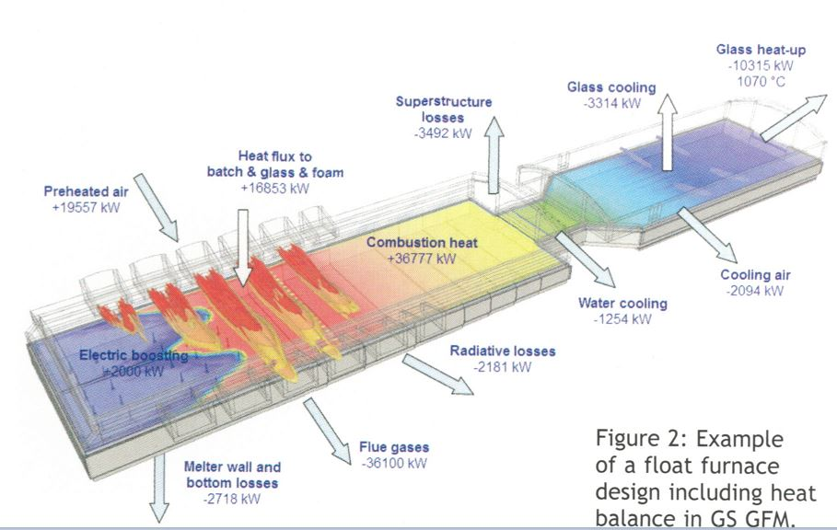

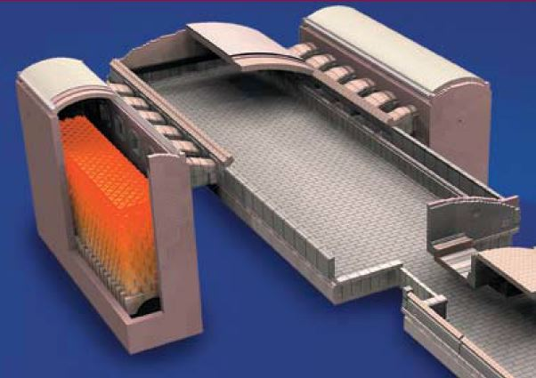
Thermal design and modeling
Verify key performance metrics via iterative design and modeling
Heat discharge rate
Heat losses
Thermal expansion of refractories
Leverage existing regenerator designs for cooling air flow
Optimize glass pool depth for tradeoff between heat losses and discharge performance
Mature modeling software available from glass industry
Refractory checker-brick regenerator

Slide 22
Budget and timeline
 | Phase 2 |  |  |  | Phase 3
Task or Milestone | 1 | 2 | 3 | 4 | 5 | 6 | 7 | 8
1. Thermal cycling testing of refractories
Refractory selection with guidance from established vendors
Develop test methodology (ramp rate, soak time, temperatures)
Perform thermal cycling tests
Evaluate results. Verify that some candidates survive intact.
2. System design
System specifications based upon market need
Preliminary design
Toll Gate: Thermal cycling pass, preliminary design feasible
3. Corrosion testing of refractories
Refractory downselection with candidates from previous phase
Develop test methodology (ramp rate, soak time, temperatures)
Perform corrosion tests
Evaluate results. Verify that some candidates survive intact.
4. Thermal modeling to verify desired charge and discharge rates
Build model based upon design developed in previous phase
Vary parameters (flow path, gas composition, gas velocity)
Iterate design and verify desired discharge rate
5. Final report to document results of experimental work and modeling
Toll Gate: Corrosion test pass, sufficient discharge rate feasible
$425,000 budget, 8 month project in two phases
Phase 2: $250,000. Refractory thermal testing and system design.
Phase 3: $175,000. Corrosion testing, thermal modeling and design iteration.

Slide 23
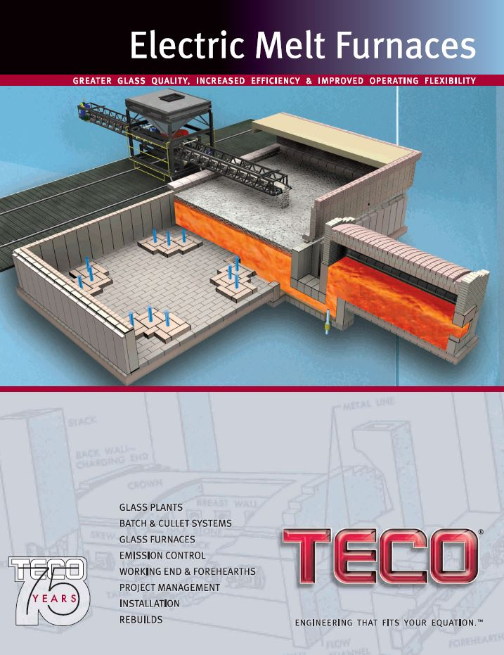


Follow on plan
Pilot plant with strategic partners at location TBD
Typical utilities require minimum of 1 MW plant with 1 year of operational data to be considered “proven technology”

Slide 24
Extra slides

Slide 25
Outline
Halotechnics overview
Market need for storage
Summarize Phase 1 results
Molten glass energy storage
Technical risks are real but can be mitigated with GameChanger project

Slide 26

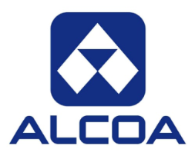






Halotechnics, Inc. – Corporate Profile
Low cost energy storage is the key to abundant clean energy
Halotechnics: An industrial technology company focused on molten salt and molten glass systems
We offer engineering design services, equipment, and proprietary salt materials to our customers
Founded in 2009 as a spin-out of Symyx Technologies (SMMX), the pioneer of high throughput chemistry
22,000 salt mixtures screened to date, patents filed on novel materials and system designs
Financing
$6.5 million in federal grants from NSF, DOE, NREL, and ARPA-E (2009-2014)
$1.05 million subcontract from Alcoa (2014-2016)
$1.5 million contract from CEC pending (2015-2017)
Organization
Headquartered in Emeryville, California
12,000 square foot chemistry and engineering labs
12-person team with molten salt and energy experience (engineers, chemists, power sector professionals)
Select Partners and Customers

Slide 27
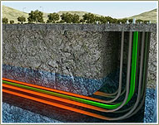
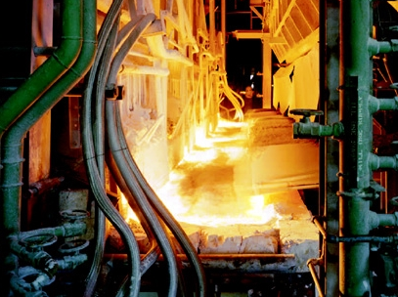
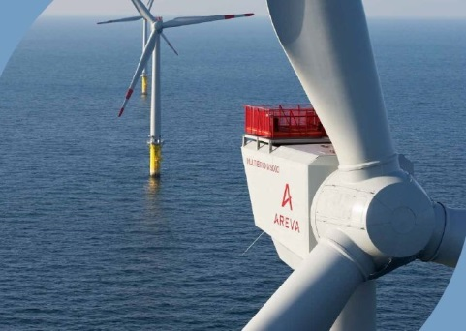
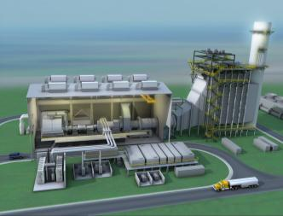
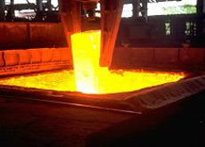
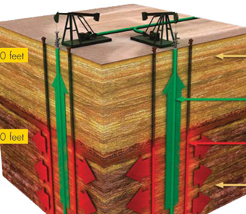
Halotechnics Product Markets
Heavy oil upgrading
Reliable
wind power
Glass manufacturing
Renewable peaker plant
Steel manufacturing
In-situ oil shale conversion
Aluminum
smelting
Thermal Electricity Storage
Waste Heat Recovery
Energy
Halotechnics Thermal Fluids Platform

Slide 28
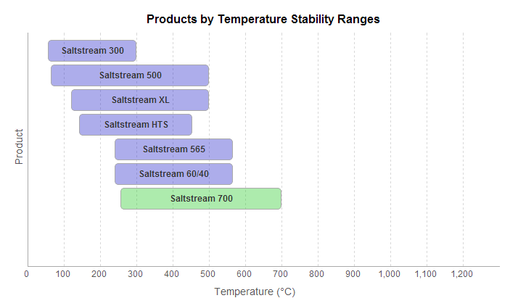
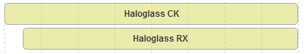
Halotechnics Products
Halotechnics products were developed by screening over 23,000 unique mixtures
We aim to deliver value-driven products from industrially available chemicals.
Saltstream and Haloglass
Enabling a new class of applications in extreme heat
www.halotechnics.com/products

Slide 29
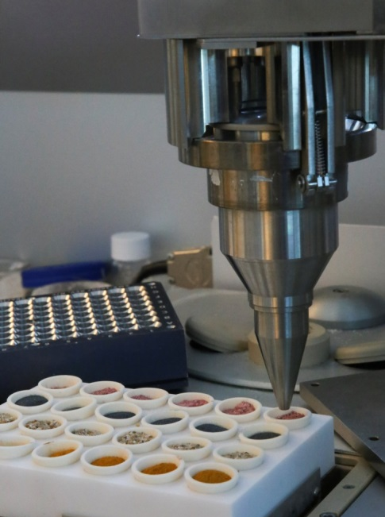
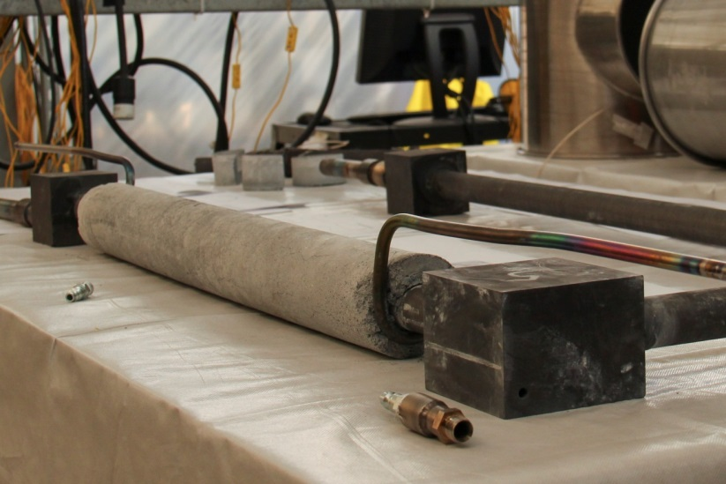
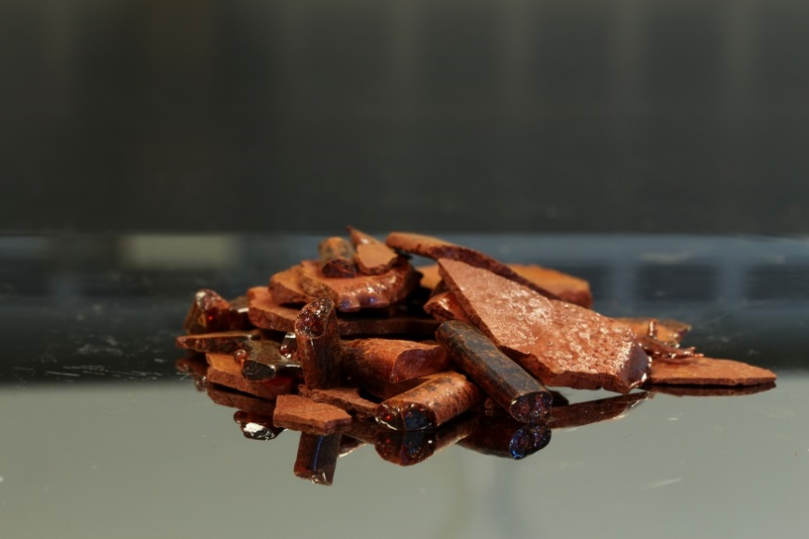
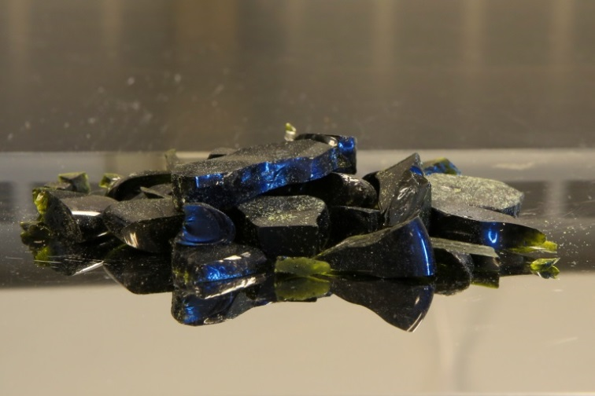
Broad experience with glass at Halotechnics
(a)
(b)
High throughput glass chemistry screening
Graphite piping from molten glass test loop after testing at 1100 °C
Proprietary vanadium-based glass
Proprietary phosphate-based glass
(c)
(d)

Slide 30
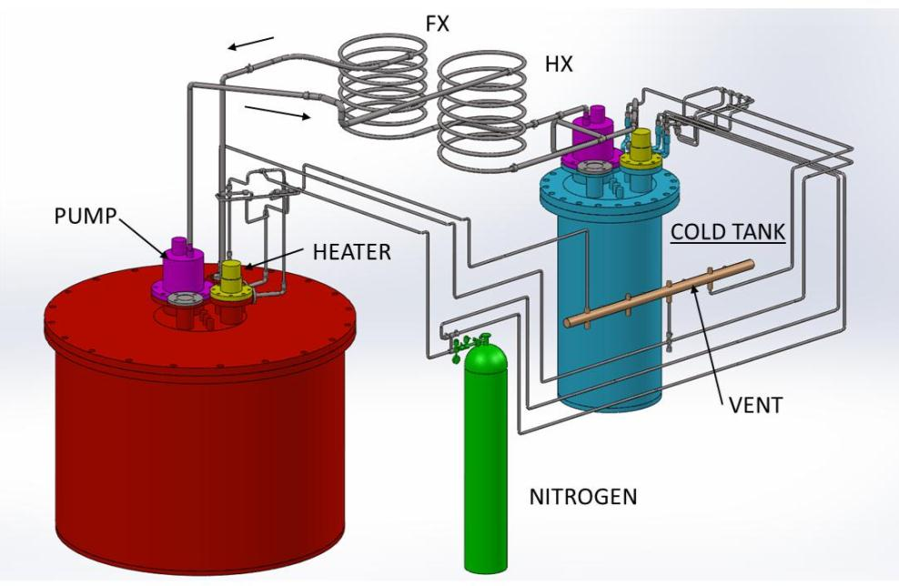
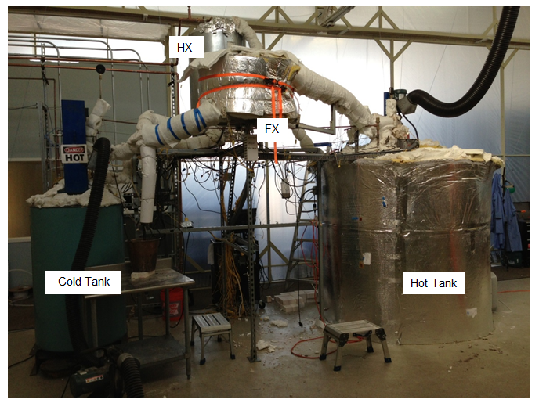
Experience with molten salt systems
5 kW
5 kW
HOT TANK
Pilot scale 700 °C molten salt thermal storage system (30 kWh, 2,000 kg salt, proprietary chloride composition)
Funded by $1 million NREL SunShot Incubator award (2012-2013)
Executed aggressive 15 month project schedule, from design to experimental data
Notes:
Halotechnics is developing the complete engineering solutions for thermal storage systems in addition to the materials science development of the fluids

Slide 31
Renewable energy needs electricity storage
12,000 MW of storage is needed in California alone
46,000
44,000
From Storage
42,000
40,000
38,000
36,000
12,000 MW
34,000
32,000
30,000
28,000
26,000
24,000
Electricity
Demand (MW)
Demand minus solar and wind
22,000
20,000
0:00
1:30
3:00
4:30
6:00
7:30
9:00
10:30
12:00
13:30
15:00
16:30
18:00
19:30
21:00
22:30
0:00
Time of Day (2020 projected load)

Slide 32

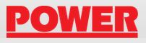
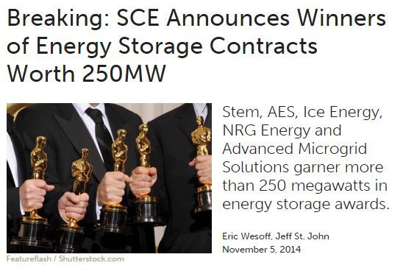
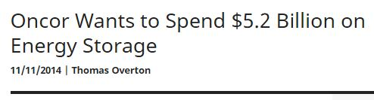
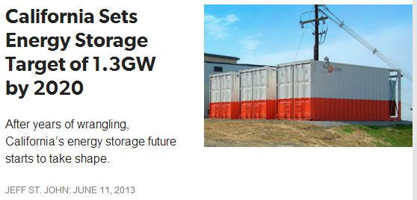
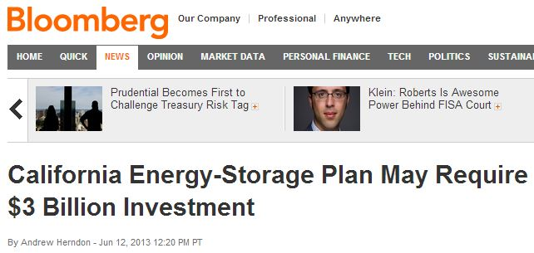
Gathering momentum for storage

Slide 33
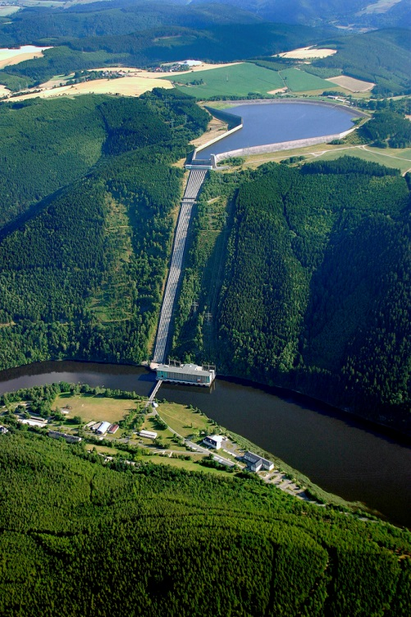
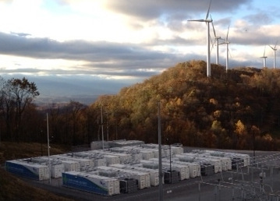
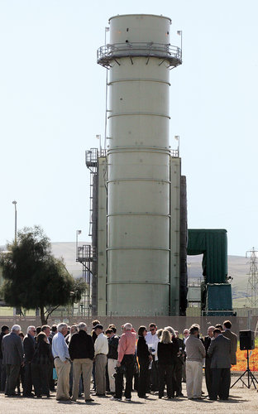
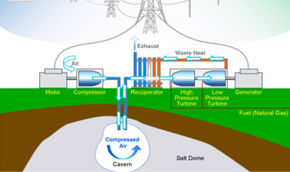
Our competition cannot meet the need
Batteries –
too expensive
Peaker plants – CO₂, NO_{x} pollution
Pumped hydro – can’t site it
Compressed air –
can’t site it

Slide 34
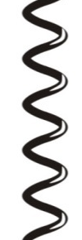
Phase 1 work: Down-selected plant schematic
Generator
Charging
Discharging
steam turbine
565 °C
Electricity
Waste heat (optional)
290 °C

Slide 35
Charge
Initial charge: glass at 1000 °C
Charge via electrode heaters immersed in glass

Slide 36
Store energy
Fully charged.
Glass at 1500 °C

Slide 37
Initial discharge
Discharge via convective and radiative heat transfer to cooling gas
Add bubblers in glass to reduce stratification
Must control gas outlet temperature
Target air outlet temp: 600 °C

Slide 38
Final discharge
Fully discharged.
Glass returns to 1000 °C

Slide 39
System layout
Energy can be delivered with air to the power block for electricity generation
Boiler
Steam Turbine
Generator
Electricity In
Electricity Out
Blower
Air Intake
Air Outlet
Energy storage
Heat transfer
Energy conversion

Slide 40
Budget justification
Item | Description | Cost
Direct Labor | labor rates | $70,500
Overhead and Fringe Benefits | rent, legal, patents, SG&A, benefits | $70,500
Materials and Supplies | refractory samples, glass samples | $4,000
Equipment | N/A | $0
Travel | visit glass engineering firm, glass modeling firm, test lab | $10,000
Consultants | glass chemistry, test method development | $6,000
Subcontracts |  | $264,000
Thermal cycling test lab |  | $53,000
Glass engineering firm |  | $94,000
Glass corrosion test lab |  | $57,000
Glass modeling firm |  | $60,000
TOTAL ($) |  | $425,000
Aggressive project scope and timeline requires staffing of experienced professionals
0.4 FTE Project Manager (thermal/mechanical engineer)
0.4 FTE Staff Scientist (chemist)
0.2 FTE CEO (system architecture, techno-economic analysis)

Slide 41
Market-driven deliverables
Commercial Requirement | Technical Deliverable | Phase
Decentralized power generation | Design plant with 20-50 MW rated power | Phase 2
>10 year plant life | At least one commercially available refractory suitable for lining the glass reservoir. Suitability is defined as less than 50% loss of strength (as measured by the modulus of rupture) after 200 thermal cycles. | Phase 2
>10 year plant life | A wall design that can tolerate repeated thermal expansion cycles | Phase 2
<10 hour charge duration | Electrode heater arrangement that can charge glass inventory with >40 MW of heating power | Phase 2
>10 year plant life | At least one commercially available refractory suitable for lining the glass reservoir. Suitability is defined as less than 10 mm/year measured corrosion rate. | Phase 3
4 hour discharge duration | Adequate heat flux from the glass during discharge in order to achieve a discharge duration of four hours (defined as >200 kW/m² heat transfer rate from glass surface at maximum and minimum operating temperatures of glass) | Phase 3
Note: Technical deliverables above are for base-case design: 40 MW, 4 hour storage plant with a glass pool 22 m x 22 m x 1.8 m, operating between 1500 °C max and 1000 °C min

Slide 42
Plant lifetime
Assume plant with following dispatch profile (similar to natural gas peaker plants)
Every day in the spring months: Mar, Apr, May → 90 days
Every day in fall months: Sep, Oct, Nov → 90 days
Once every 7-10 days in other months: → 20 days
Typical year sees 200 days of use. Therefore 10 year life requires an estimated 2000 charge/discharge cycles

Slide 43
From spec, to design, to model
Halotechnics to perform:
Energy storage market knowledge and customer outreach
Refractory testing method development and glass selection
System specification (design concept, footprint and tank sizing, PFD)
Tentative subcontracts:
Mo-Sci (refractory thermal cycling and corrosion testing)
TECO (preliminary design based upon spec)
Glass Service (thermal modeling based upon preliminary design)
Market constraints
Available refractories
System specification
Preliminary design
Thermal modeling
Validated design
Iterative feedback

Slide 44
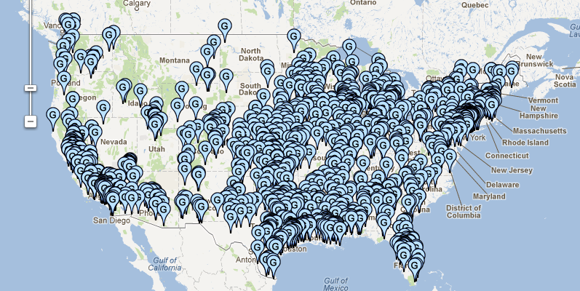
SteamBoost project potential
Deploy SteamBoost and HeatBoost at plants nationwide
1100 MW of boost potential in California
10,000 MW nationwide
Data obtained from http://GlobalEnergyObservatory.org/

